Slide 1
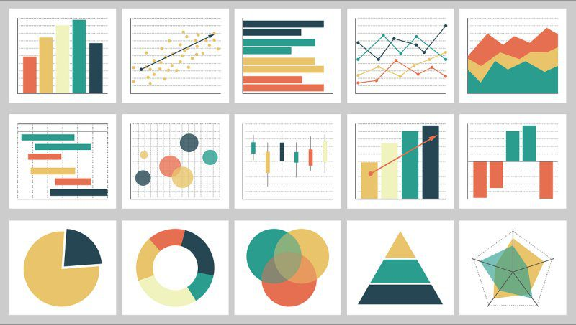
Week 3: Descriptive statistics/Exploratory Data Analysis
Geog4300: Shannon

Slide 2
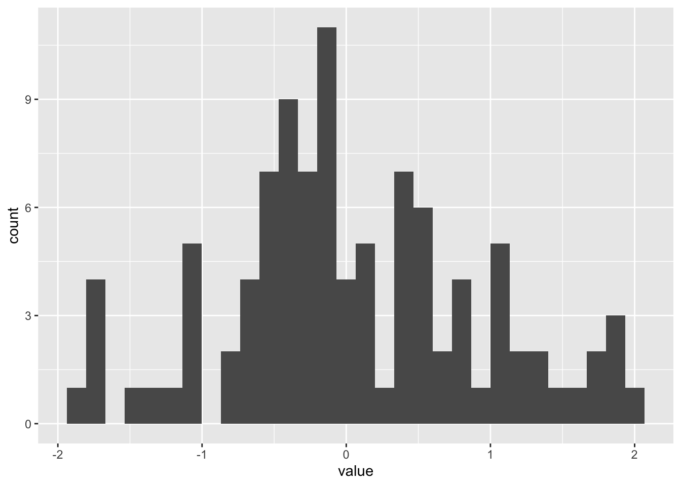
This week: Descriptive statistics
Measures of central tendency:
Mean
Median
Mode
Measures of distribution:
Standard deviation
Interquartile range (IQR)
Coefficient of variation

Slide 3
Which measure of central tendency should we use for the number of UGA football games we have attended?
exactly 1 | 23
NA | 8
none as of now | 5
0 | 0
2 | 10
none | 0
12 | 0
0 | 1
7 | 5
3 | 0
2 | ~15

Slide 4

What’s a related question we could ask for which mode would be the appropriate measure of central tendancy?

Slide 5
Summary statistics for our county data in Excel
For LessHSPct and HSGradPct
Calculate the mean, median and standard deviation
Calculate the 1st and 3rd quartiles as well as the IQR. The function in Excel is =QUARTILE(column,quartile #)
Combine the two variables into a single one (HS Graduate or below) and calculate the same statistics for that variable
Notes:
Depending your approach, classification methods can paint very different pictures of the same data points.
How might we interpret the natural breaks map differently from the quantiles map here?

Slide 6

Let’s roll!
Roll your dice 10 times.
What’s the mean (sum of all rolls/10) and median (average of two middle values) of these rolls? Do they differ?
What’s the IQR?

Slide 7
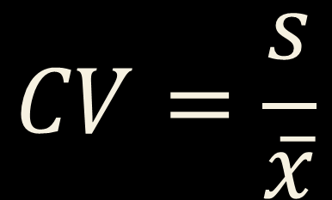
Coefficient of variation
Standard deviation divided by the mean
Useful when means vary across groups or measures
$$CV=\frac{s}{\overline{x}}$$

Slide 8


R challenge!
Load the Daymet data we will use in lab 1 and calculate the mean, standard deviation (sd), and cv for prcp by county. You’ll need to use group_by, summarise, and mutate.
Which counties have the highest cv? How does that compare to standard deviation?
$$CV=\frac{s}{\overline{x}}$$

Slide 9
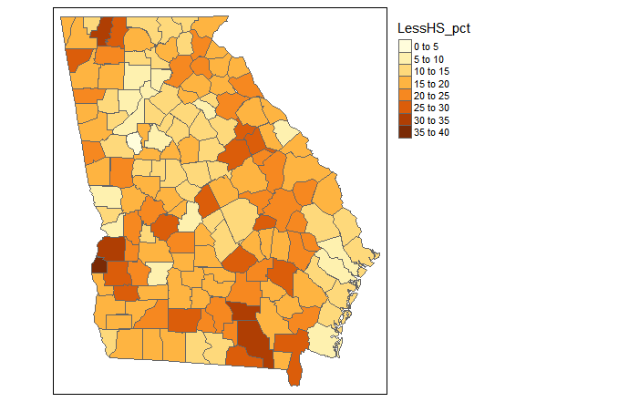
Desriptive states in action:
What’s a “low education county?”
Notes:
Depending your approach, classification methods can paint very different pictures of the same data points.
How might we interpret the natural breaks map differently from the quantiles map here?

Slide 10
How could we decide?
Based off the data/Relative measure
How many standard deviations below the mean?
What percentile of all counties?
Based off the research/Absolute measure
What’s the average of a larger area (e.g., national/international)?
What are the recommendations of experts in the field (e.g., Department of Education, past research)?
Notes:
Depending your approach, classification methods can paint very different pictures of the same data points.
How might we interpret the natural breaks map differently from the quantiles map here?

Slide 11
You try it!
Use the education data you created earlier:
Group 1: Identify counties in the top quartile for not completing high school (LessHSPct)
Group 2: Use the LessHSPct and HSGradPct variables. Identify counties in the top quartile for this figure.
Group 3: Identify counties more than 2 standard deviations higher than the mean for LessHSPct
Group 4: Use the LessHSPct and HSGradPct variables. Identify counties more than 2 standard deviations above the mean.
Group 5: Identify upper outliers for the LessHSPct variable. The threshold is the 3rd quartile value + 1.5 * the IQR
Notes:
Depending your approach, classification methods can paint very different pictures of the same data points.
How might we interpret the natural breaks map differently from the quantiles map here?

Slide 12
You try it!
How would you classify a “low-education county” based on these data? What might that miss?
Notes:
Depending your approach, classification methods can paint very different pictures of the same data points.
How might we interpret the natural breaks map differently from the quantiles map here?

Slide 13


Tukey and Wickham on Exploratory Data Analysis
Notes:
Depending your approach, classification methods can paint very different pictures of the same data points.
How might we interpret the natural breaks map differently from the quantiles map here?

